Slide 1

IDENTIFYING PATTERNS IN WATER TREATMENT EFFICIENCY USING CLUSTERING TECHNIQUES
Department of Computer Science and Engineering
Seshadri Rao Gudlavalleru Engineering College, Gudlavalleru
Under the Guidance of
Dr.G.SriDevi ,M.Tech(PhD)
B.SRAVANTHI (21481A0543)
ABDUL KAIF (21481A0501)
B.YAGNA PRIYANKA (21481A0531)
D.SAI GANESH (21481A0561)

Slide 2
CONTENTS
01
02
03
Introduction
Problem Statement
Proposed Method
04
05
Results
Conclusion

Slide 3
Abstract
This project aims to enhance water treatment efficiency by identifying patterns in water quality measurements using clustering techniques such as K-Means and Hierarchical clustering. The dataset "WATER_TREATMENT" contains various parameters measured at entry (E), primary (P), secondary (S), and tertiary (D) phases, including pH, BOD, COD, SS, SSV, SED, COND, and zinc concentration. It also includes reductions (RD) of these parameters across different phases. By applying these clustering techniques, we seek to categorize water samples with similar characteristics at different stages. This analysis will uncover patterns and relationships, optimizing operations and improving the effectiveness of water treatment facilities to ensure a safe and clean water supply.

Slide 4
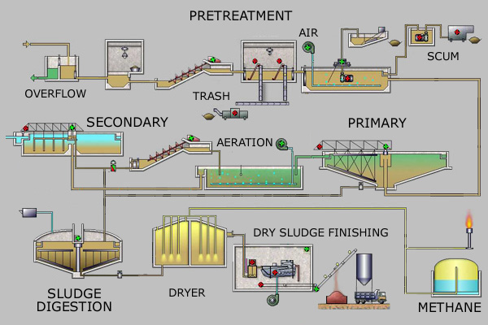
introduction
The "WATER_TREATMENT" dataset comprises water quality measurements taken at various stages of the treatment process: entry (E), primary (P), secondary (S), and tertiary (D) phases.
It includes parameters such as ph, biochemical oxygen demand (bod), chemical oxygen demand (cod), suspended solids (ss), volatile suspended solids (ssv), sediment (sed), conductivity (cond), and zinc concentration (zn).
This comprehensive dataset is crucial for analyzing and identifying patterns to optimize water treatment processes, enhancing overall efficiency and effectiveness
.

Slide 5
Problem Statement
The project aims to identify patterns in water treatment efficiency using clustering techniques on a comprehensive dataset of water quality measurements. By categorizing water samples with similar characteristics at different treatment stages, the analysis seeks to optimize operations and enhance the effectiveness of water treatment facilities, ensuring a safe and clean water supply.

Slide 6
Methodology
The analysis of various data mining algorithms, the algorithms that are used in this model are K-Means and Hierarchical Clustering Algorithms which can be helpful for Water Treatment efficiency.

Slide 7
Dataset description
The dataset used in this project contains comprehensive water quality measurements taken from different stages of the water treatment process.
These measurements are crucial for understanding the efficiency effectiveness of the treatment process.
Each column in the dataset represents a specific parameter measured at various stages, providing a detailed snapshot of water quality before, during, and after treatment.

Slide 8
The dataset in this project captures a rich array of water quality measurements from various stages of the water treatment process.
Each measurement plays a crucial role in assessing the efficiency of the water treatment, enabling a detailed analysis that can inform improvements and optimizations.
The data includes parameters such as flow rate, zinc concentration, pH levels, biological oxygen demand (BOD), chemical oxygen demand (COD), suspended solids (SS), volatile suspended solids (VSS), sediments, and conductivity.
These parameters are recorded at the entry stage, primary treatment stage, secondary treatment stage, and tertiary treatment stage, providing a thorough overview of the water treatment lifecycle.

Slide 9
different stages of the water treatment process
1. Entry Point (E): Measurements taken at the initial entry of raw water into the treatment plant.
2. Primary Treatment (P): Measurements after primary treatment, which typically involves the removal of large particles and sediments.
3. Secondary Treatment (D): Measurements after secondary treatment, which often includes biological processes to remove dissolved and suspended organic matter.
4. Sludge Processing (S): Measurements related to the treatment and processing of sludge, a byproduct of water treatment.
5. General (G):Combined or overall data reductions observed across different stages of process.

Slide 10
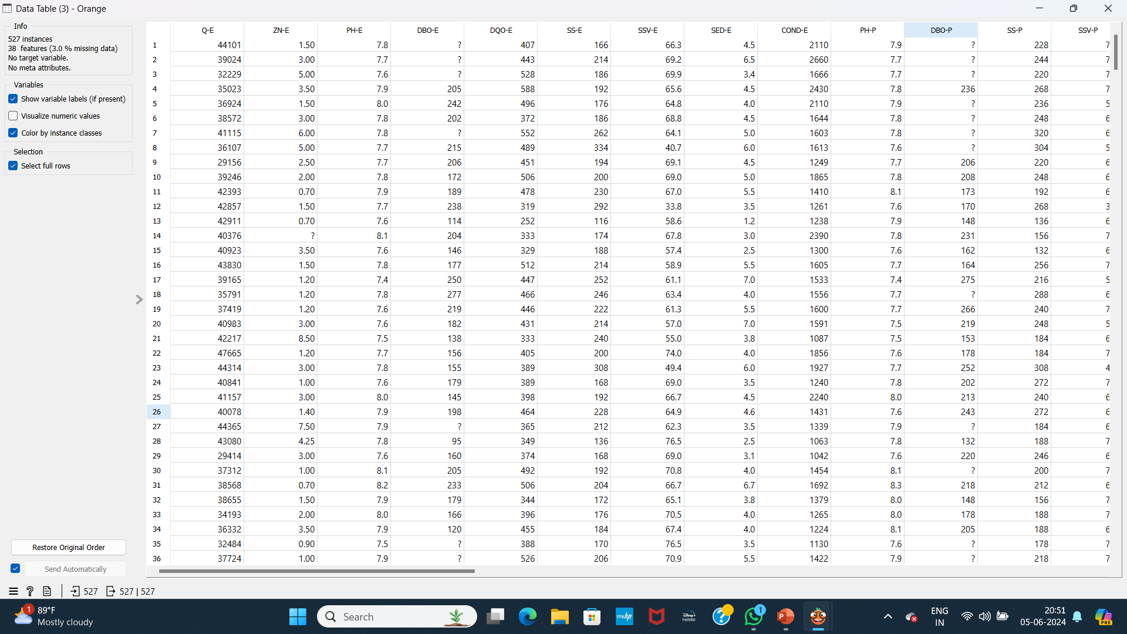
DataSET BEFORE preprocessing

Slide 11
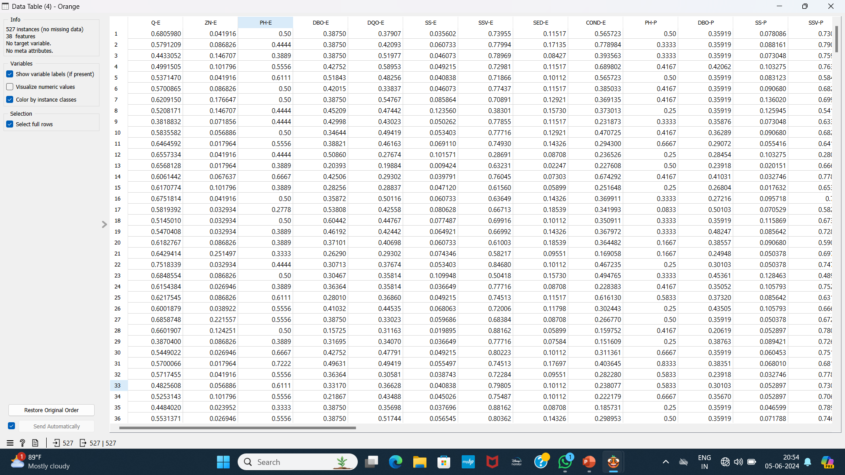
DataSET after preprocessing

Slide 12
K-Means clustering Algorithm
K-Means clustering is a popular unsupervised machine learning algorithm used to partition data into k distinct clusters based on feature similarity. The algorithm works by initializing k centroids, one for each cluster, and then iteratively assigning each data point to the nearest centroid and updating the centroids based on the mean of the assigned points. This process repeats until convergence, typically when the assignments no longer change. The primary objective of K-Means is to minimize the within-cluster variance, creating compact and well-separated clusters. It's computationally efficient and works well with large datasets. However, it requires specifying the number of clusters in advance and may struggle with clusters of varying shapes and sizes.

Slide 13
Algorithm: k-means. The k-means algorithm for partitioning, where each cluster’s center is
represented by the mean value of the objects in the cluster.
Input:
• k: the number of clusters,
• D: a data set containing n objects.
Output: A set of k clusters.
Method:
(1) arbitrarily choose k objects from D as the initial cluster centers;
(2) repeat
(3) (re)assign each object to the cluster to which the object is the most similar, based on the
mean value of the objects in the cluster;
(4) update the cluster means, that is, calculate the mean value of the objects for each
cluster;
(5) until no change;

Slide 14
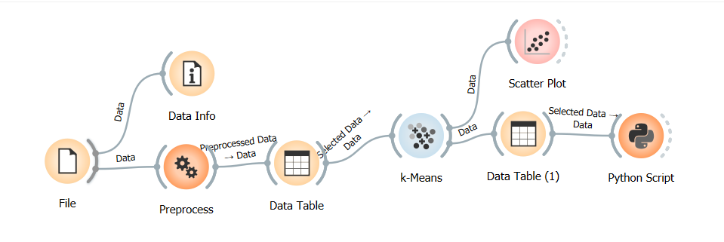
Workflow of K-Means

Slide 15
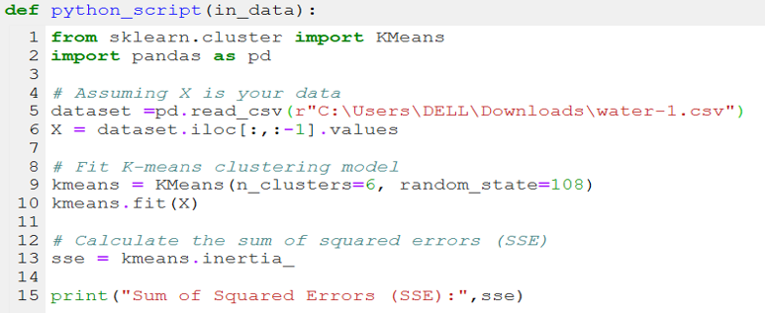
Python script

Slide 16
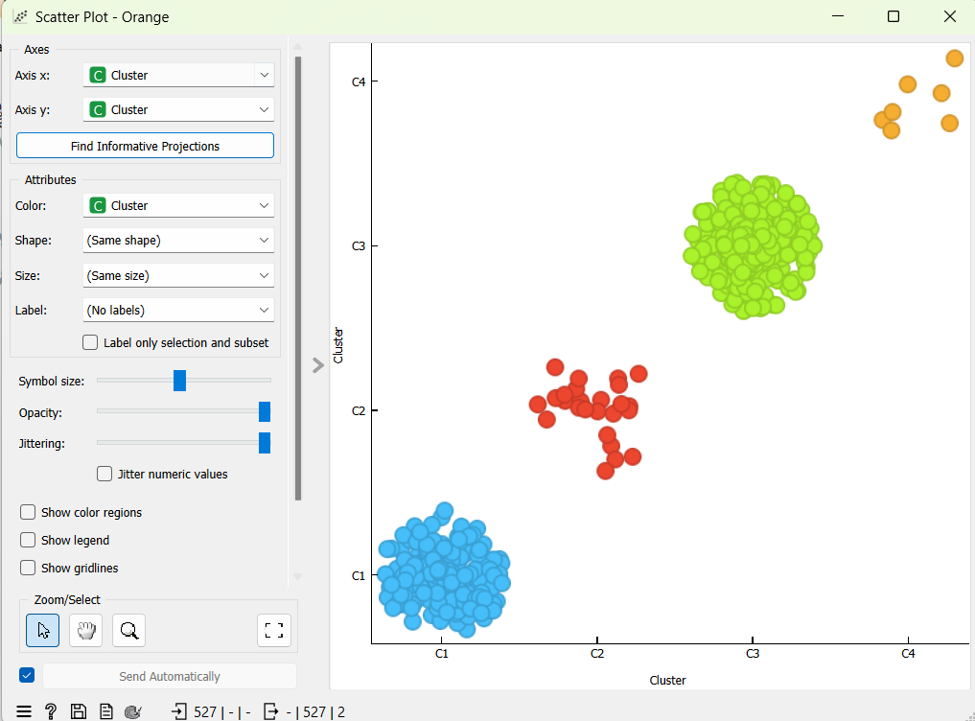
Output for k-means

Slide 17
Hierarchical clustering algorithm
Hierarchical clustering is an unsupervised machine learning algorithm used to build a hierarchy of clusters through either agglomerative (bottom-up) or divisive (top-down) approaches.
In the agglomerative approach, each data point starts as its own cluster, and pairs of clusters are merged iteratively based on their similarity until a single cluster remains.
Conversely, the divisive approach begins with one cluster containing all data points and splits them iteratively. The results are visualized using a dendrogram, which shows the nested grouping of clusters. Hierarchical clustering does not require specifying the number of clusters in advance and is useful for understanding data structure. However, it can be computationally intensive and sensitive to noise and outliers.

Slide 18

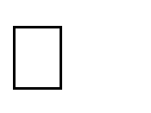
Algorithm: Hierarchical Clustering
Input:
k: the number of clusters,
D: a data set containing n objects
Output:
A hierarchical clustering represented as a dendrogram.
Method:
Initialization:
Create n clusters, each containing one of the n objects.
Compute the initial distance matrix D, where D[i, j] is the distance between the i-th and j-th objects.
Repeat:
Find the Closest Clusters:
Identify the two clusters Ci and Cj that are closest, i.e., have the smallest distance in the distance matrix D.
Merge Clusters:
Merge clusters Ci​ and Cj​ into a new cluster Cij​.
Update Distance Matrix: Update the distance matrix to reflect the distance between the new cluster Cij​ and all other existing clusters.
Use a chosen linkage criterion (single, complete, average, centroid) to compute the distance between Cij​ and each remaining cluster.
Until:
All objects are merged into a single cluster or another stopping criterion is met.

Slide 19
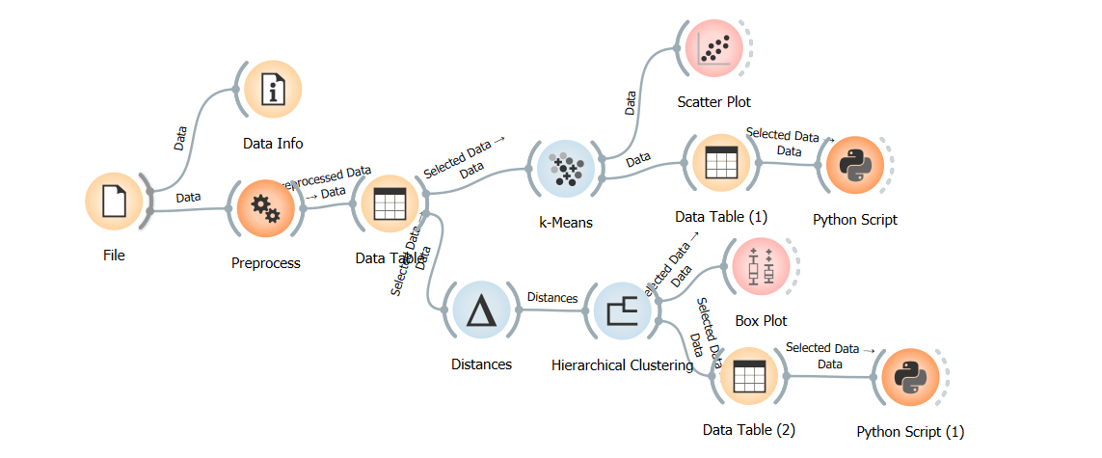
Workflow of Hierarchical

Slide 20
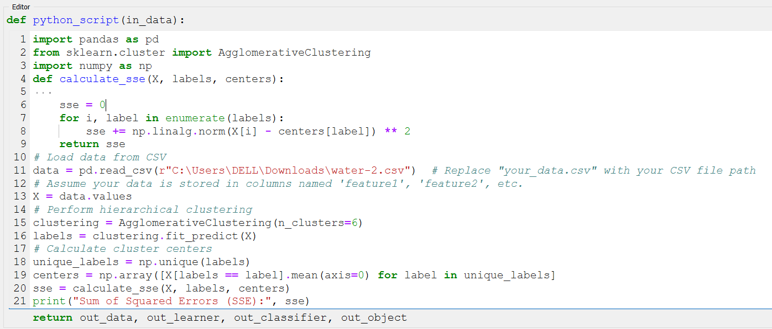
Python script

Slide 21
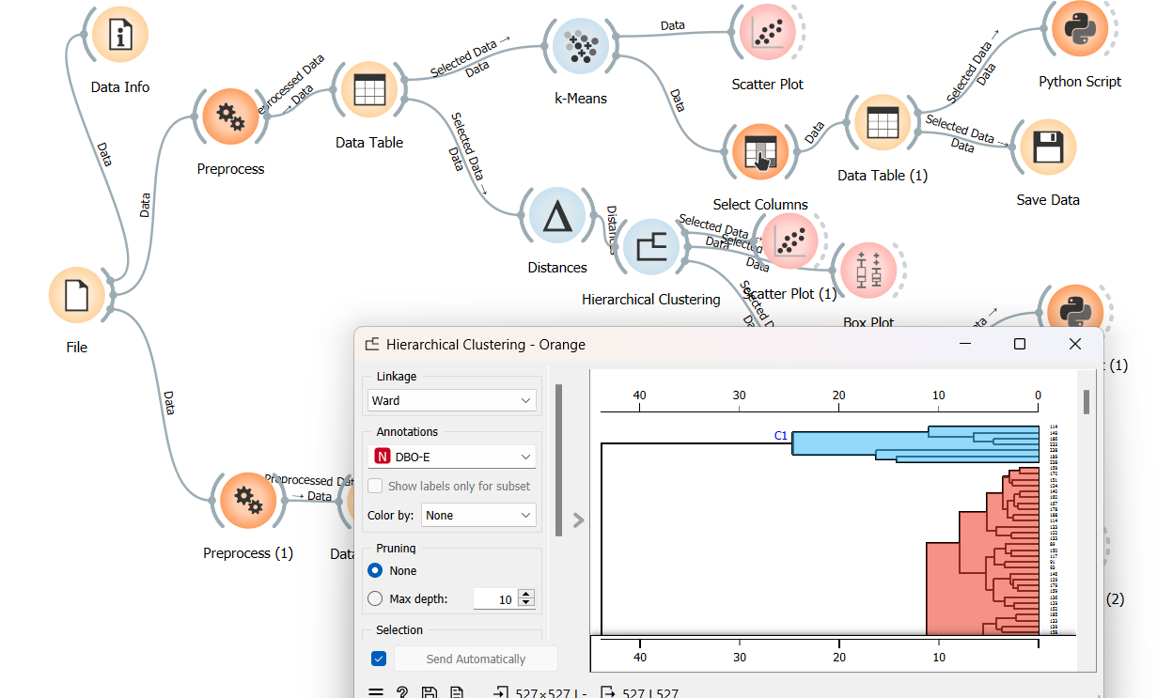
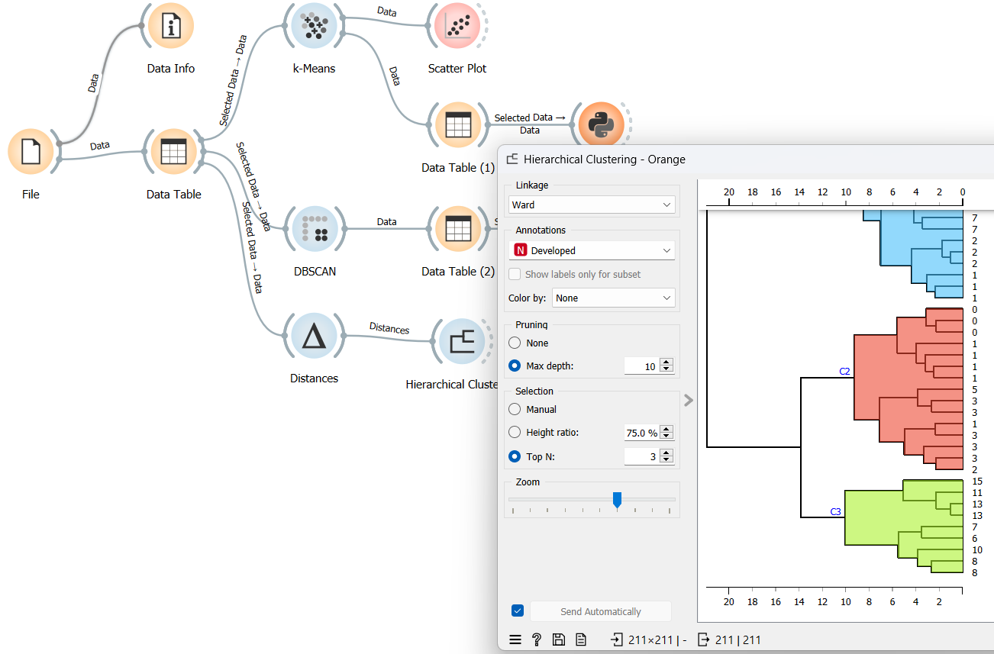
Output:

Slide 22
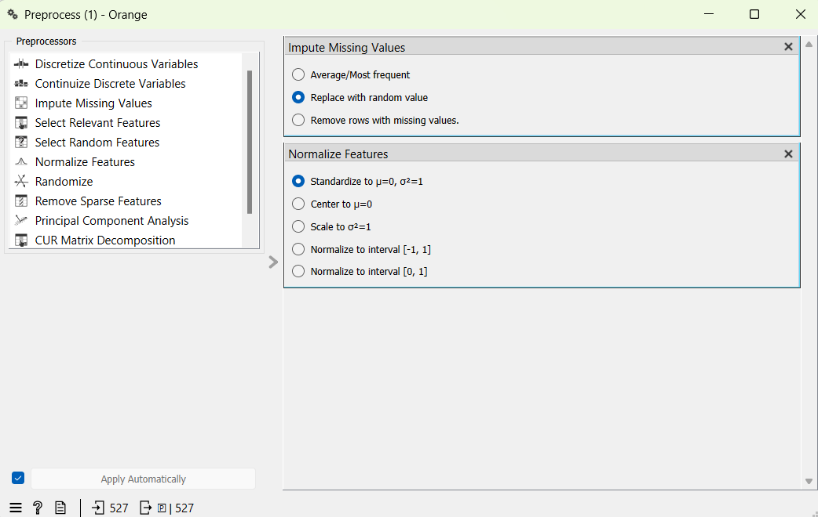
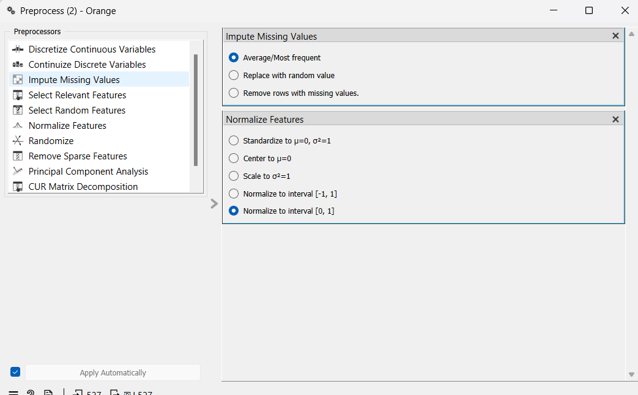
Normalizing Data

Slide 23
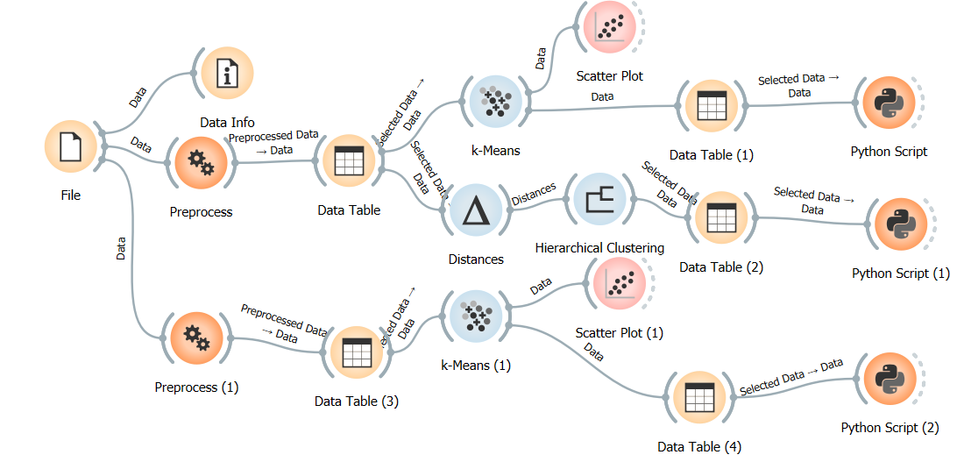
K-Means

Slide 24
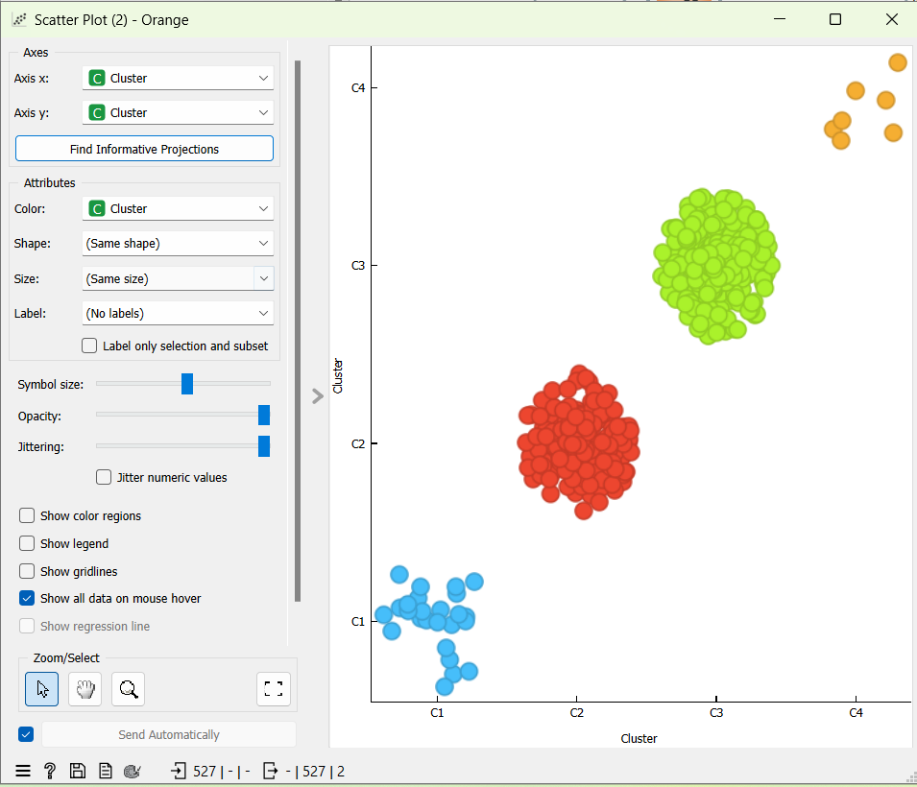
Before Normalization
After Normalization

Slide 25
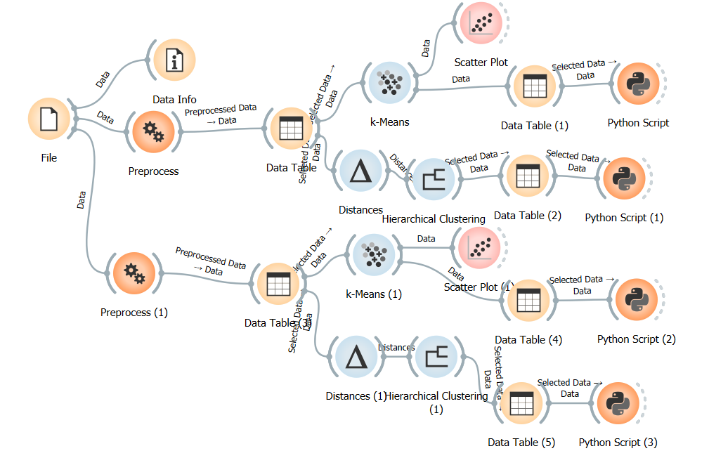
Hierarchical Clustering

Slide 26
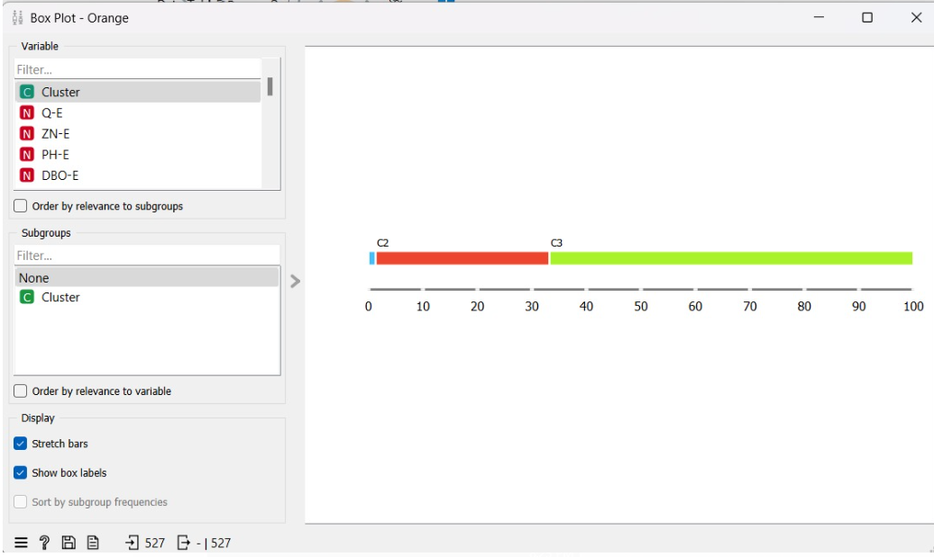
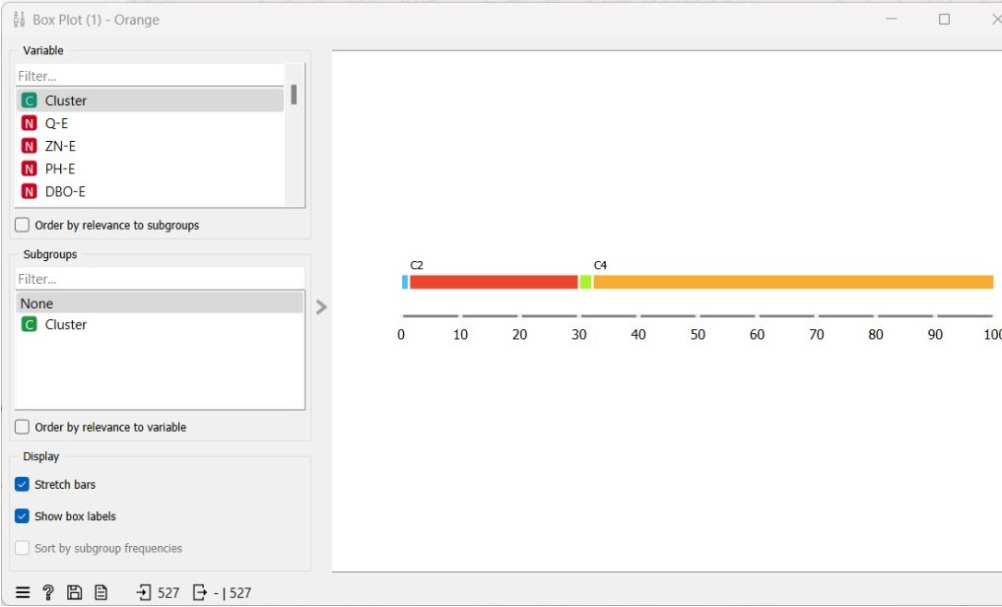
Before Normalization
After Normalization

Slide 27
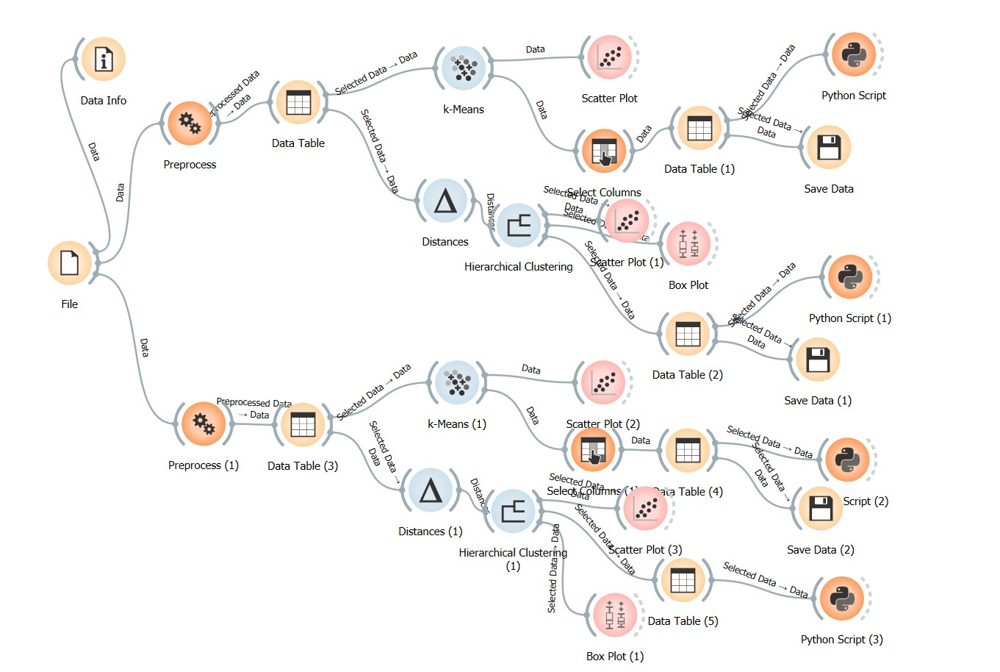
OVERALL WORKFLOW

Slide 28
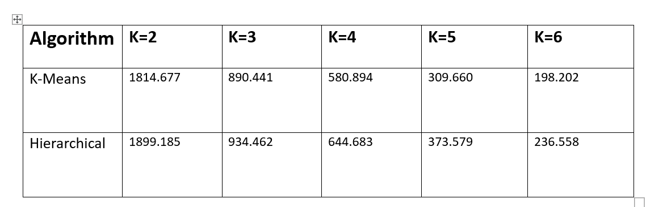
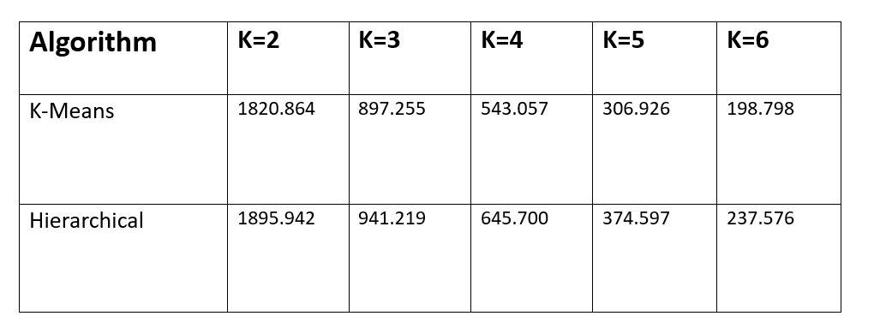
SUM of SQUARED ERROR
Before Normalization
After Normalization

Slide 29
analysis
By applying and comparing k-means, and hierarchical clustering to the water treatment dataset, we found after normalization at k=4 sum of squared error is reduced.
The silhouette score value is highest at k=4 i.e. 0.126.
After analyzing sum of squared error before and after normalization, the K-Means algorithm is best suited for the water treatment dataset rather than hierarchical clustering.
Using K-means algorithm for clustering in the context of water treatment analysis can provide good clusters.

Slide 30
conclusion
K-means clustering: k-means effectively identified distinct clusters representing different operational states in the water treatment process, such as high contamination periods and efficient treatment phases, providing actionable insights for optimizing process performance.
Hierarchical clustering: hierarchical clustering offered a detailed view of the relationships between water quality parameters, revealing a nested structure of clusters and subtle variations in treatment efficiency, thereby enhancing the understanding of the treatment process dynamics.

Slide 31
THANK YOU

